Slide 1
OA3103: Data Analysis
Evaluation of Linear Regression

Slide 2

Admin
HW due today
2359 tonight$→$0900 tomorrow
Sakai updated to allow multiple submissions
Lab on Wednesday is not yet “official” but we will plan to push ahead and
1400 in GL-122

Slide 3
References
ISLP: Chapter 3
Linear Regression and Linear Models, Statquest by Josh Starmer
Playlist ID: https://youtube.com/playlist?list=PLblh5JKOoLUIzaEkCLIUxQFjPIlapw8nU&si=50QaW8q6zee5jiuX

Slide 4

Goals for Today
Further our understanding of evaluating linear models by leveraging intuition from OA3102.
$R^{2}≔$ how much of the variation in $Y$ is explained by $X$
F-statistic$≔$ the statistical significance of our linear model

Slide 5


Concept Review: Estimating One-Dimensional Data
Suppose we have a bunch of values $y_{i}$. What is the best estimator for them?
Weight

Slide 6

Concept Review: Estimating One-Dimensional Data
We evaluate how good our estimate is by the Mean Square Error (MSE)
The MSE of one-dimensional data is Variance.
Weight

Slide 7

When we have an additional variable…
We want to evaluate if knowing something else about the data points (some set of $x_{i}$ for each $y_{i}$) tells us more than just the $y_{i}$ data by itself.

Slide 8
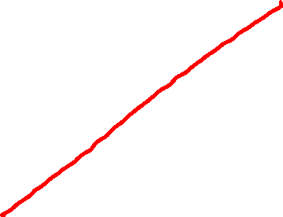
When we have an additional variable
If we have two data points, we can fit a line perfectly between them.

Slide 9
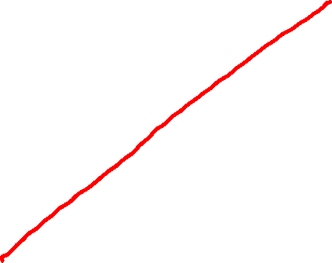
When we have an additional variable
But what if we have more?
In linear algebra, this meant we were overdetermined.

Slide 10
When we have an additional variable
So last week, we fit the line using the least squares estimator.
But how good is this fit?

Slide 11
An Intuitive Look
Pediatric Patients: Estimating Weight
Which of these two is a more effective predictor of weight?
Weight
Weight
Height
Favorite Color

Slide 12
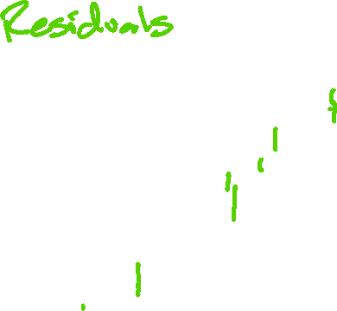
Again: MSE
We look at the vertical distances of the data points to our prediction.
What are these called again?
In this case, we square each of these distances, and take their mean. (MSE)

Slide 13
Simple Linear Regression
Last week we used calculus to find the slope and the y-intercept of the Least Squares Estimator (LSE) line.
We proved that the LSE is the solution that minimizes MSE.

Slide 14
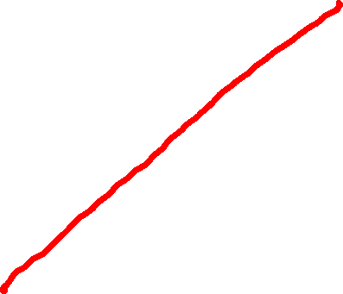
Simple Linear Regression
Think of choosing the slope and y-intercept as rotating the best fit line, and calculating the resulting MSE.

Slide 15


Simple Linear Regression
If we plot that rotation vs MSE, then what we did was select the rotation at the bottom of the curve.
Calculated MSE
$\hat{y}={\hat{β}}_{1}x+{\hat{β}}_{0}$

Slide 16

Simple Linear Regression
With univariate data (just $y_{i}$) we said the best estimate was the mean.
Weight

Slide 17

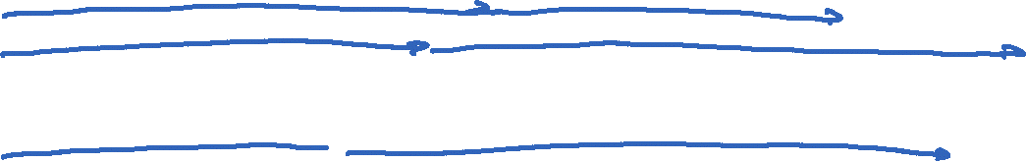
Simple Linear Regression
With two-dimensional data, notice the $y_{i}$ values are the same. They are just ordered differently WRT the predictors $x_{i}$.
Weight
Weight
Weight
Height
Favorite Color

Slide 18

Simple Linear Regression
If the estimator is essentially meaningless, then the slope ${\hat{β}}_{1}=0$ and the y-intercept ${\hat{β}}_{0}=𝔼[Y]$.
Weight
Weight
Favorite Color

Slide 19


Simple Linear Regression
In other words, when the predictor variable is not useful at all, the sums of the squared errors (residuals) is the same as the sum of the squared errors of $\left\{y_{i}\right\}$ by itself, $Var[Y]$.
Weight
Weight
Favorite Color

Slide 20

Takeaway
We can say that predicting $Y$ using just the observed $y_{i}$ itself is the same as predicting $Y$ using $(x_{i},y_{i})$ when the least squares estimator line has zero slope.

Slide 21
Meaningful Predictor
When we do see a predictor variable that appears to have meaning, then we would fit a line with a non-zero slope.
Weight
Height

Slide 22


Simple Linear Regression
In this case, we expect the sum of the squared errors to be less than if we had predicted $Y$ as $𝔼[Y]$.
Weight
Weight
Height

Slide 23
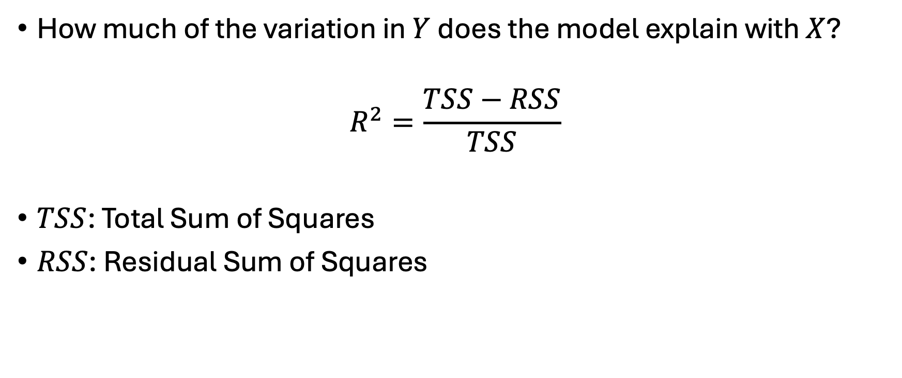
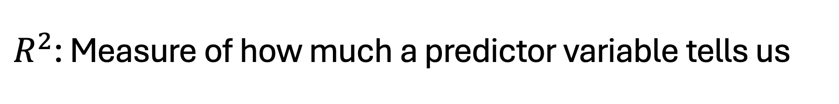
$R^{2}$: Measure of how much a predictor variable tells us
How much of the variation in $Y$ does the model explain with $X$?
$$R^{2}=\frac{TSS−RSS}{TSS}$$
$TSS$: Total Sum of Squares
$RSS$: Residual Sum of Squares

Slide 24

$R^{2}$: Measure of how much a predictor variable tells us
How much of the variation in $Y$ does the model explain with $X$?
$$R^{2}=\frac{SS_{mean only }−SS_{fit}}{SS_{mean only}}$$

Slide 25
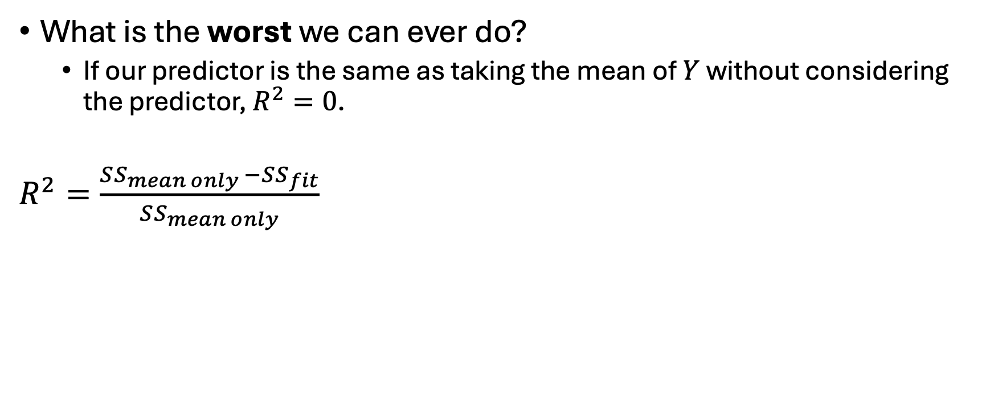

Let’s unpack this some more
What is the worst we can ever do?
If our predictor is the same as taking the mean of $Y$ without considering the predictor, $R^{2}=0$.
$R^{2}=\frac{SS_{mean only }−SS_{fit}}{SS_{mean only}}$
Weight
Weight
Favorite Color

Slide 26
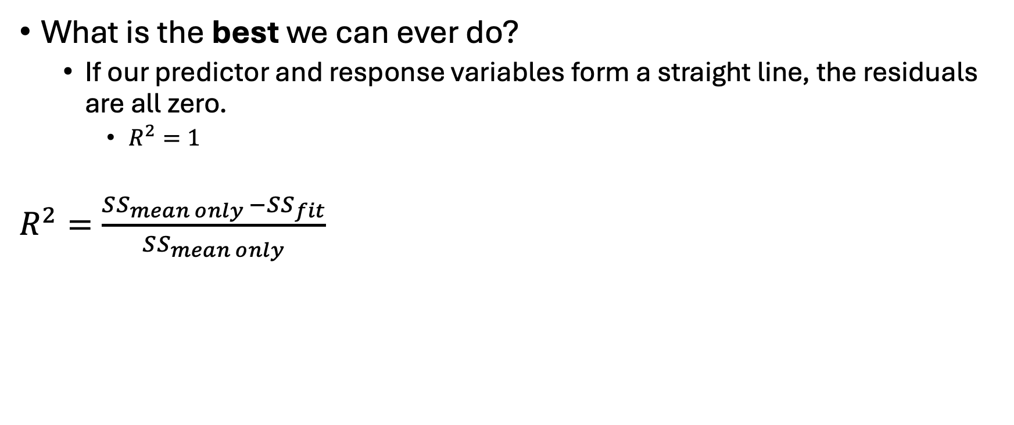

Let’s unpack this some more
What is the best we can ever do?
If our predictor and response variables form a straight line, the residuals are all zero.
$R^{2}=1$
$R^{2}=\frac{SS_{mean only }−SS_{fit}}{SS_{mean only}}$
Weight
Weight
26
Amazing Predictor

Slide 27

Why this works
Recall the first of our “big three” assumptions:
Weight
Weight
Weight
Height
Favorite Color

Slide 28
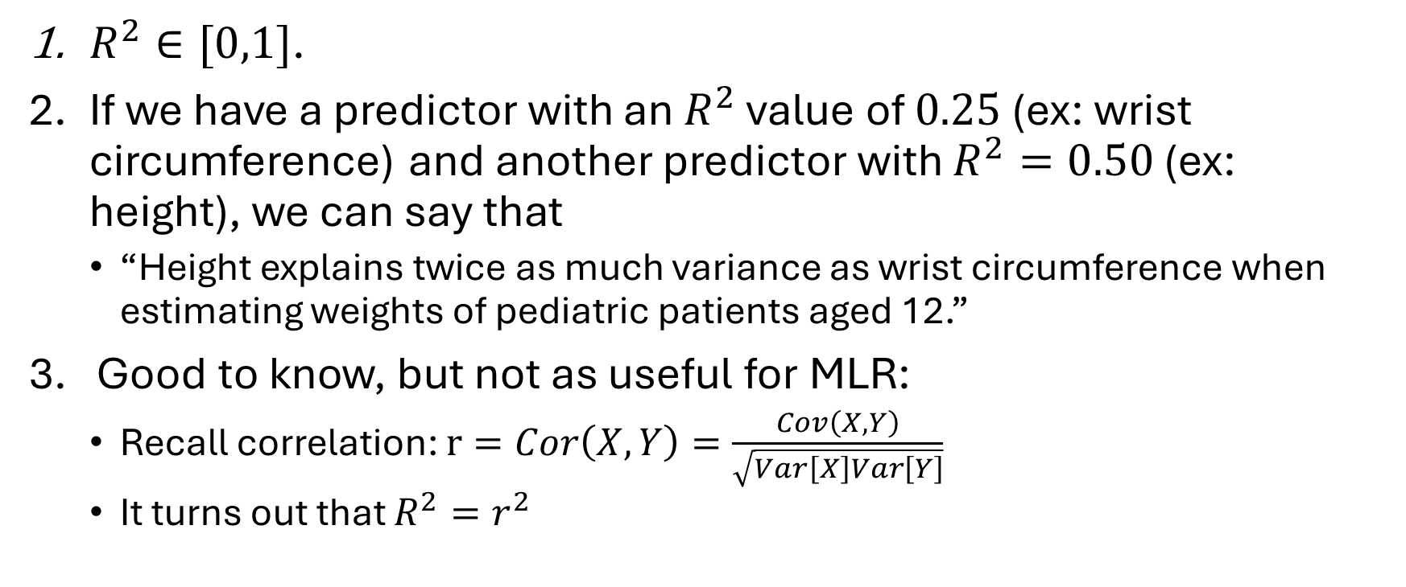
Takeaways
$R^{2}∈[0,1]$.
If we have a predictor with an $R^{2}$ value of $0.25$ (ex: wrist circumference) and another predictor with $R^{2}=0.50$ (ex: height), we can say that
“Height explains twice as much variance as wrist circumference when estimating weights of pediatric patients aged 12.”
Good to know, but not as useful for MLR:
Recall correlation: $r=Cor\left(X,Y\right)=\frac{Cov\left(X,Y\right)}{\sqrt{Var\left[X\right]Var\left[Y\right]}}$
It turns out that $R^{2}=r^{2}$

Slide 30

Limitations
$R^{2}$ doesn’t tell us everything.
Example: What if we had only two data points?

Slide 31

Limitations
Example: What if we had only two data points?
$SSE=0 ⇒R^{2}=1$. A perfect fit!

Slide 32

Limitations
$SSE=0 ⇒R^{2}=1$. A perfect fit!
But what if we start applying it to test data?

Slide 33
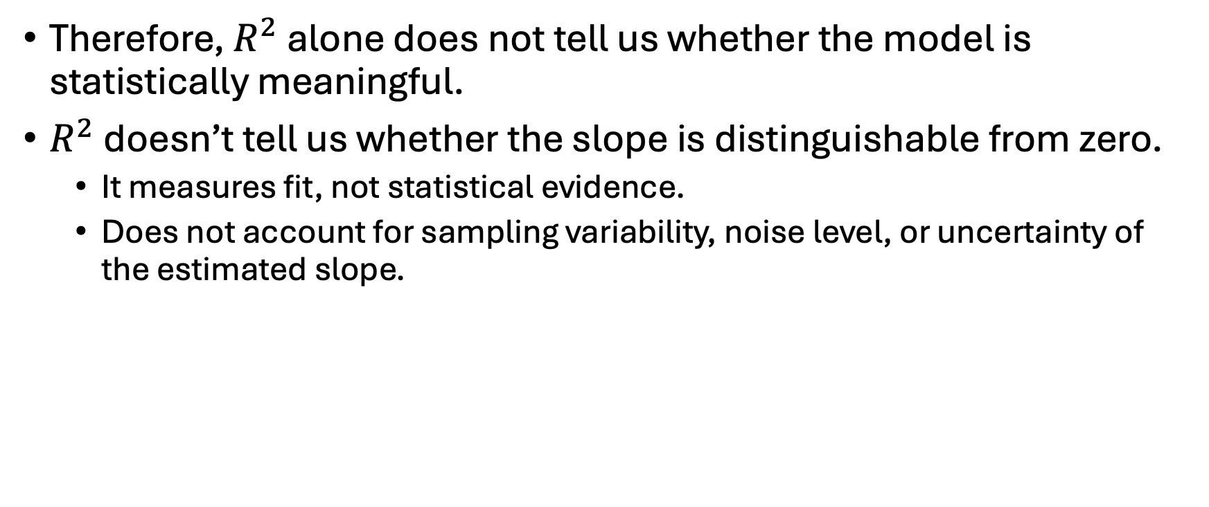
Limitations
Therefore, $R^{2}$ alone does not tell us whether the model is statistically meaningful.
$R^{2}$ doesn’t tell us whether the slope is distinguishable from zero.
It measures fit, not statistical evidence.
Does not account for sampling variability, noise level, or uncertainty of the estimated slope.

Slide 34
Enter: The F-test
We want to get a statistical significance of our fit.

Slide 35
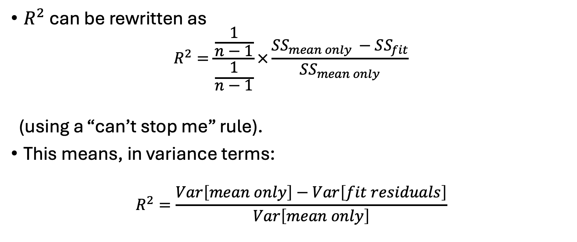

Decomposition and Comparison to $R^{2}$
$R^{2}$ can be rewritten as
$$R^{2}=\frac{\frac{1}{n−1}}{\frac{1}{n−1}}×\frac{SS_{mean only }−SS_{fit}}{SS_{mean only}}$$
(using a “can’t stop me” rule).
This means, in variance terms:
$$R^{2}=\frac{Var\left[mean only\right]−Var\left[fit residuals\right]}{Var\left[mean only\right]}$$

Slide 36
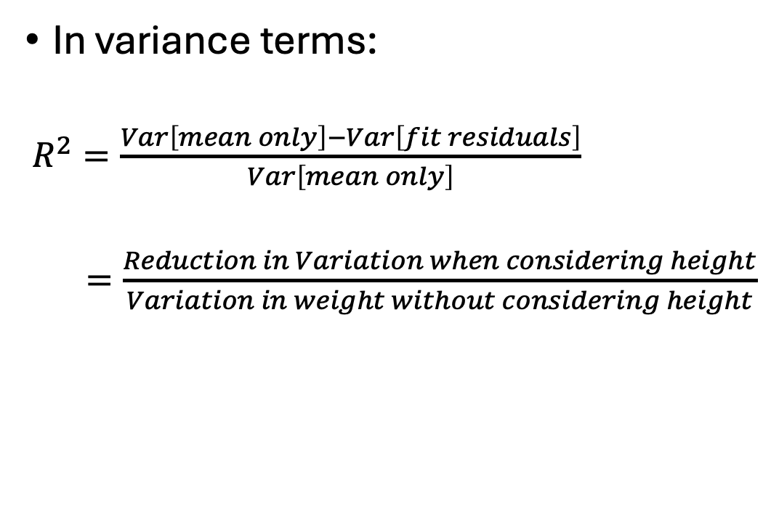
Decomposition and Comparison to $R^{2}$
In variance terms:
$R^{2}=\frac{Var\left[mean only\right]−Var\left[fit residuals\right]}{Var\left[mean only\right]}$
$=\frac{Reduction in Variation when considering height}{Variation in weight without considering height}$
Weight
Weight
Height

Slide 37
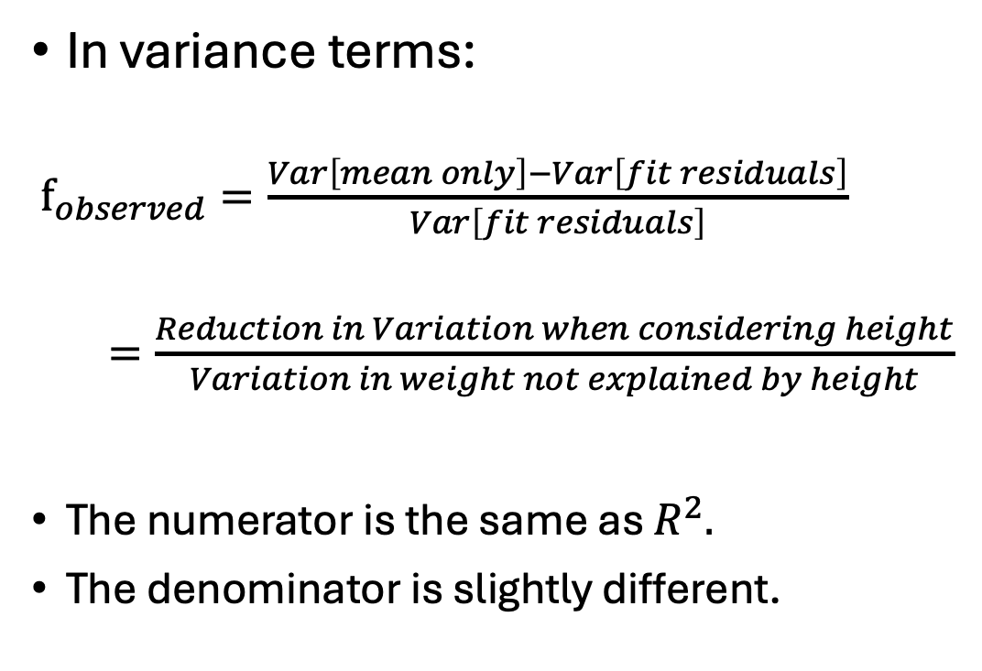
F-statistic
In variance terms:
$f_{observed}=\frac{Var\left[mean only\right]−Var\left[fit residuals\right]}{Var\left[fit residuals\right]}$
$=\frac{Reduction in Variation when considering height}{Variation in weight not explained by height}$
The numerator is the same as $R^{2}.$
The denominator is slightly different.
Weight
Weight
Height

Slide 38
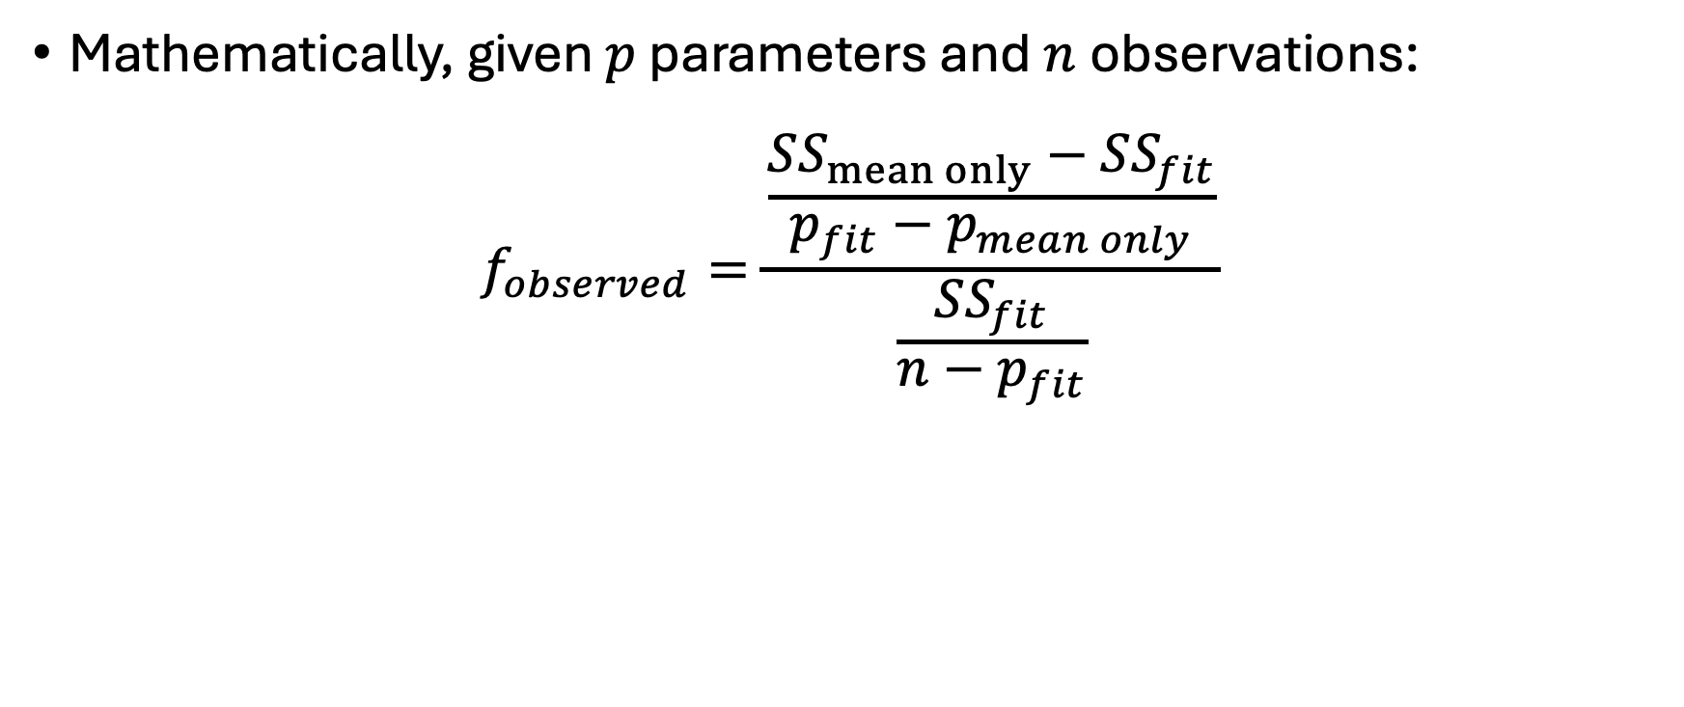
F-statistic
Mathematically, given $p$ parameters and $n$observations:
$$f_{observed}=\frac{\frac{SS_{mean only}−SS_{fit}}{p_{fit}−p_{mean only}}}{\frac{SS_{fit}}{n−p_{fit}}}$$

Slide 39
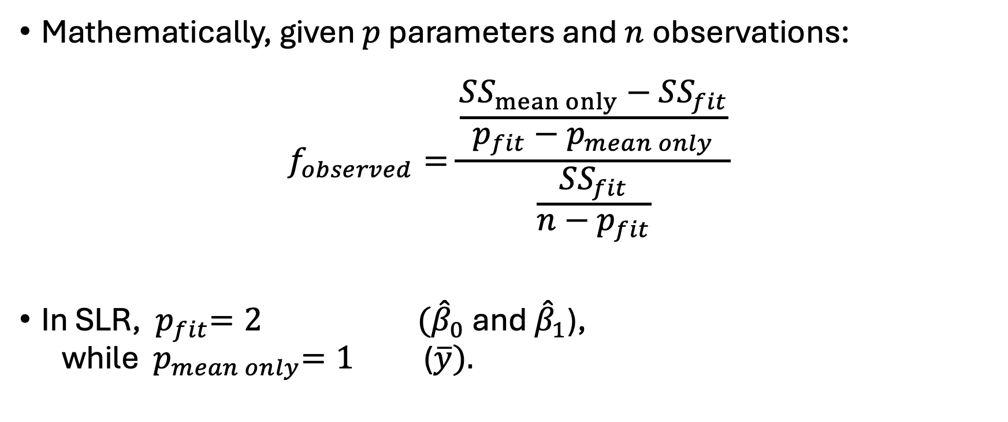
F-statistic
Mathematically, given $p$ parameters and $n$observations:
$$f_{observed}=\frac{\frac{SS_{mean only}−SS_{fit}}{p_{fit}−p_{mean only}}}{\frac{SS_{fit}}{n−p_{fit}}}$$
In SLR, ${ p}_{fit}=2 ({\hat{β}}_{0}$ and ${\hat{β}}_{1}$), while ${ p}_{mean only}=1$ ($\overline{y}).$

Slide 40
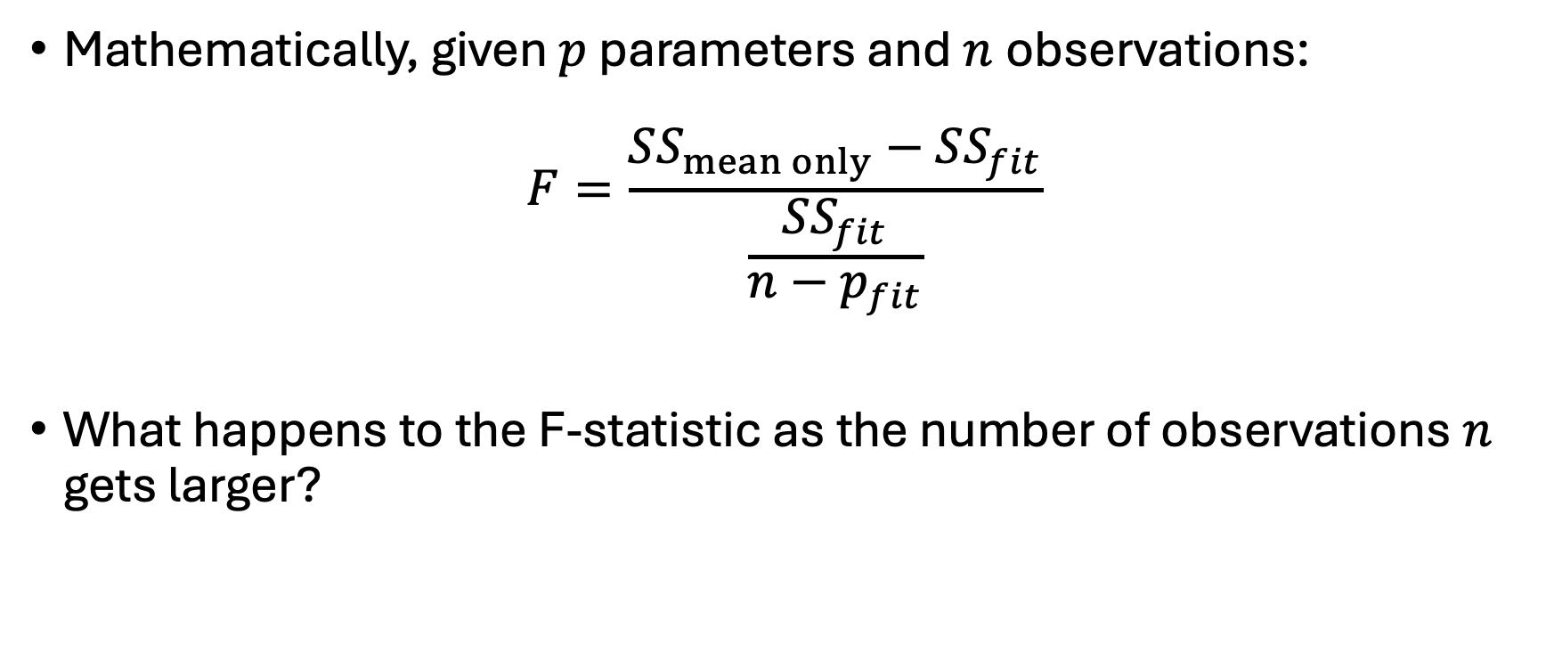
F-statistic
Mathematically, given $p$ parameters and $n$observations:
$$F=\frac{SS_{mean only}−SS_{fit}}{\frac{SS_{fit}}{n−p_{fit}}}$$
What happens to the F-statistic as the number of observations $n$ gets larger?

Slide 41
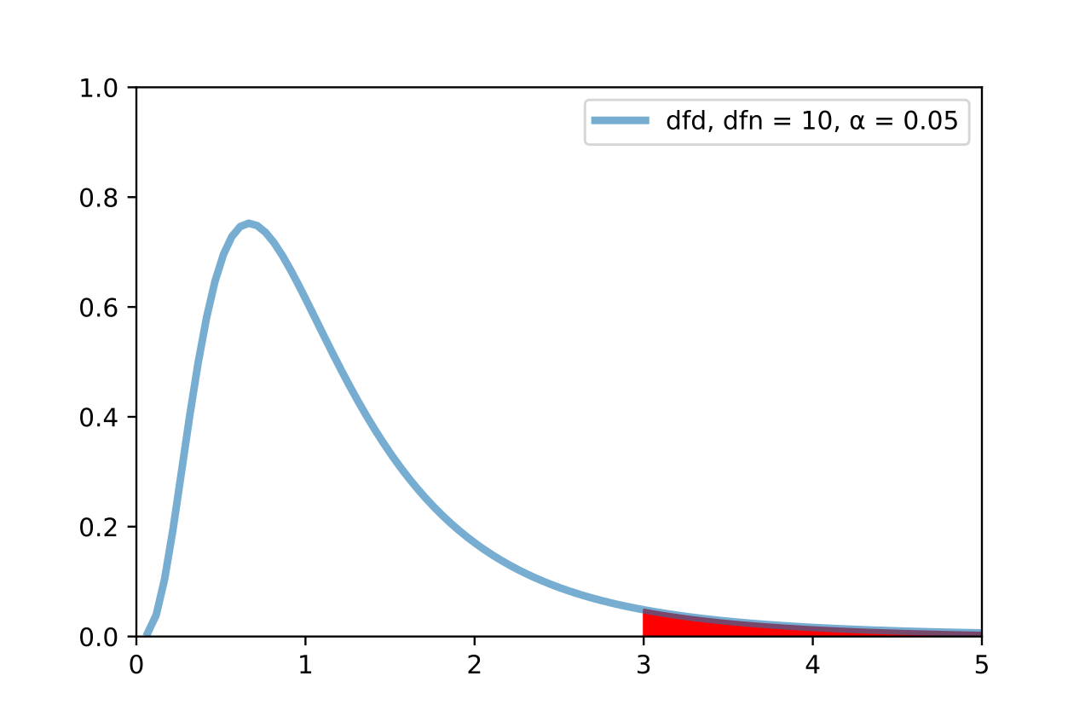

The F-Distribution
We then use the F-Distribution to calculate a p-value.
$$p=𝒫(F_{df\left(numerator\right),df\left(denominator\right)}≥f_{observed})$$
Image adapted from F-test plot.svg, Gase456, CC by 4.0. Retrieved from https://en.wikipedia.org/wiki/F-test.

Slide 42
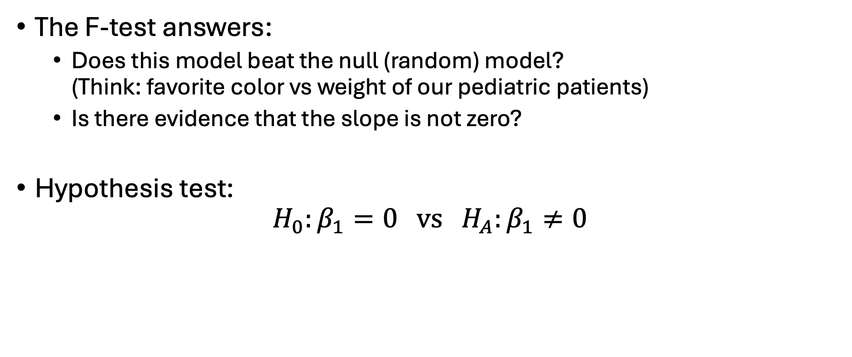
Mathematical Interpretation
The F-test answers:
Does this model beat the null (random) model? (Think: favorite color vs weight of our pediatric patients)
Is there evidence that the slope is not zero?
Hypothesis test:
$$H_{0}:β_{1}=0 vs H_{A}:β_{1}≠0$$

Slide 43
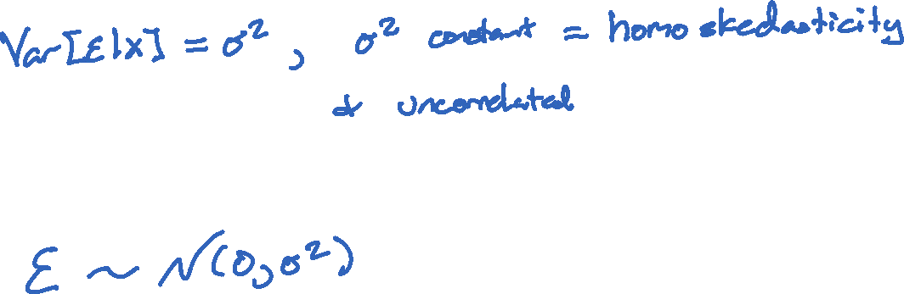
Why this works
Recall the second “big three” assumption:
And the third “big three” assumption:
And the uncorrelated assumption from #2 automatically gives us independence with the Normal/Gaussian assumption.

Slide 45
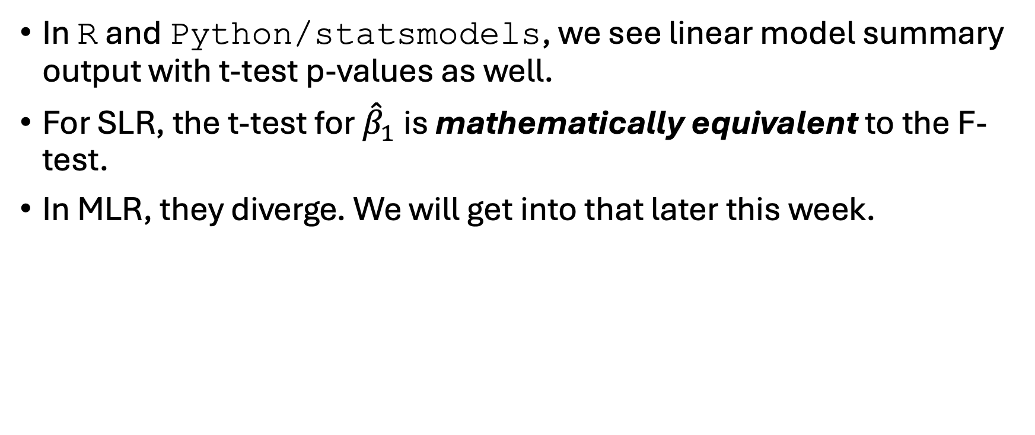
What about the t-tests?
In R and Python/statsmodels, we see linear model summary output with t-test p-values as well.
For SLR, the t-test for ${\hat{β}}_{1}$ is mathematically equivalent to the F-test.
In MLR, they diverge. We will get into that later this week.

Slide 47
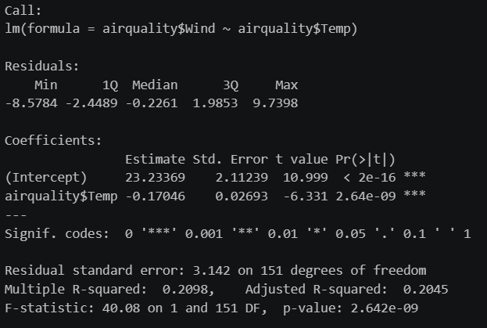


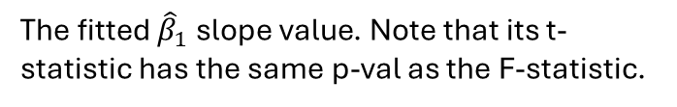
R Output
Recall that in R we use the fit <- lm()command. The summary of that fit looks like this:
The Y (response) regressed onto X (predictor).
The distribution of the residuals.
The fitted ${\hat{β}}_{0}$ y-intercept value.
The fitted ${\hat{β}}_{1}$ slope value. Note that its t-statistic has the same p-val as the F-statistic.
The $R^{2}$value. More on adjusted $R^{2}$ in MLR.
F-statistic and its p-value.

Slide 48
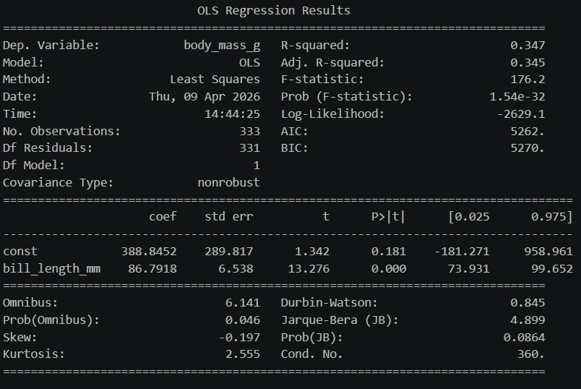



Python Output
In Python, with statsmodels imported as sm, we build a design matrix (more on that tomorrow) and the output looks like:
The Y (response) is the dependent variable.
The X (predictor) variable.
The $R^{2}$value.
F-statistic and its p-value.
The fitted ${\hat{β}}_{0}$ y-intercept value.
The fitted ${\hat{β}}_{1}$ slope value.

Slide 49

Back to R and Python
Open up your notebooks and datasets from Thursday.
Using visual EDA (scatterplot matrices and/or correlation heatmaps), compare $R^{2}$ values and F-test p-values between different variables.

Slide 50
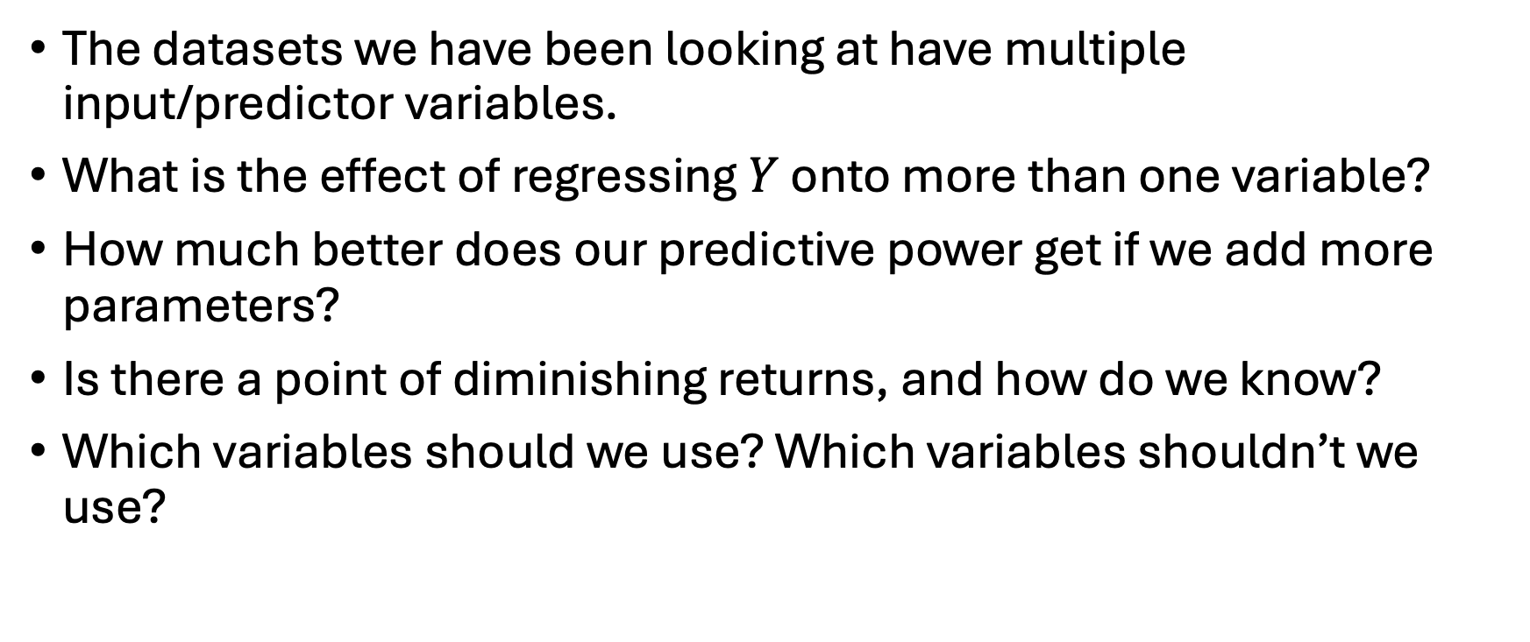
Later …
The datasets we have been looking at have multiple input/predictor variables.
What is the effect of regressing $Y$ onto more than one variable?
How much better does our predictive power get if we add more parameters?
Is there a point of diminishing returns, and how do we know?
Which variables should we use? Which variables shouldn’t we use?

